Slide 1
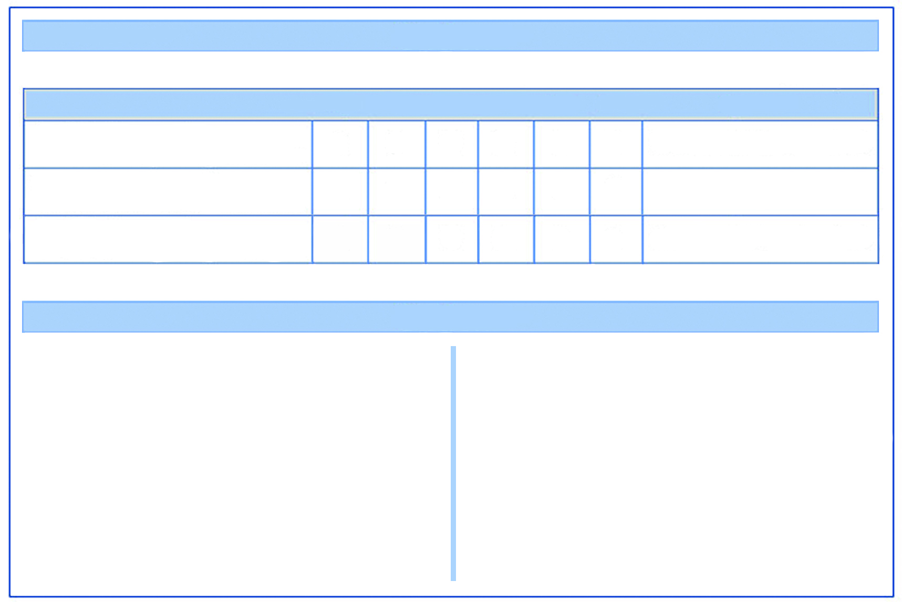
COURT WIZARD
COURT WIZARD
Warrior Unit
Points Value: 129
Warrior Unit
Points Value: 129
UNIT: COURT WIZARD
AG
ACC
STR
RES
INIT
CO
SPECIAL
UNIT: COURT WIZARD
AG
ACC
STR
RES
INIT
CO
SPECIAL
1 x Court Wizard with stave
5
5
5
5
7
8
Tough 2, Wound, Magic Level 1
1 x Court Wizard with stave
5
5
5
5
7
8
Tough 2, Wound, Magic Level 1
1 x Wizard’s Apprentice with stave
5
5
5
5
7
7
-
1 x Wizard’s Apprentice with stave
5
5
5
5
7
7
-
3 x Wizard’s Familiars
5
5
5
5
3
3
Spirit, 1 x HtH SV 1, Exchange of Missiles SV1
3 x Wizard’s Familiars
5
5
5
5
3
3
Spirit, 1 x HtH SV 1, Exchange of Missiles SV1
Special: You can include a maximum of one Court Wizard in your warband
Special: You can include a maximum of one Court Wizard in your warband
OPTIONS and SPECIAL ABILITIES
OPTIONS and SPECIAL ABILITIES
Add up to 4 Wizard’s Apprentices @9pts per model OR add up to 4 Wizard’s Familiars @18pts per model
Upgrade Court Wizard to Tough 2 @10pts
Upgrade Court Wizard to Magic Level 2 @25pts
Upgrade Court Wizard to Magic Level 3 @50pts
Give unit swords instead of staves @2pts per model
Tough 2 - can re-roll one failed res test x 2
Wound - A failed res test is a wound, a unit with a wounded model cannot remove the last pin
Spirit - Auto destroyed if the master is killed, can be sacrificed in exchange for a re-roll
Add up to 4 Wizard’s Apprentices @9pts per model OR add up to 4 Wizard’s Familiars @18pts per model
Upgrade Court Wizard to Tough 2 @10pts
Upgrade Court Wizard to Magic Level 2 @25pts
Upgrade Court Wizard to Magic Level 3 @50pts
Give unit swords instead of staves @2pts per model
Tough 2 - can re-roll one failed res test x 2
Wound - A failed res test is a wound, a unit with a wounded model cannot remove the last pin
Spirit - Auto destroyed if the master is killed, can be sacrificed in exchange for a re-roll
COURT WIZARD
COURT WIZARD
Warrior Unit
Points Value: 129
Warrior Unit
Points Value: 129
UNIT: COURT WIZARD
AG
ACC
STR
RES
INIT
CO
SPECIAL
UNIT: COURT WIZARD
AG
ACC
STR
RES
INIT
CO
SPECIAL
1 x Court Wizard with stave
5
5
5
5
7
8
Tough 2, Wound, Magic Level 1
1 x Court Wizard with stave
5
5
5
5
7
8
Tough 2, Wound, Magic Level 1
1 x Wizard’s Apprentice with stave
5
5
5
5
7
7
-
1 x Wizard’s Apprentice with stave
5
5
5
5
7
7
-
3 x Wizard’s Familiars
5
5
5
5
3
3
Spirit, 1 x HtH SV 1, Exchange of Missiles SV1
3 x Wizard’s Familiars
5
5
5
5
3
3
Spirit, 1 x HtH SV 1, Exchange of Missiles SV1
Special: You can include a maximum of one Court Wizard in your warband
Special: You can include a maximum of one Court Wizard in your warband
OPTIONS and SPECIAL ABILITIES
OPTIONS and SPECIAL ABILITIES
Add up to 4 Wizard’s Apprentices @9pts per model OR add up to 4 Wizard’s Familiars @18pts per model
Upgrade Court Wizard to Tough 2 @10pts
Upgrade Court Wizard to Magic Level 2 @25pts
Upgrade Court Wizard to Magic Level 3 @50pts
Give unit swords instead of staves @2pts per model
Tough 2 - can re-roll one failed res test x 2
Wound - A failed res test is a wound, a unit with a wounded model cannot remove the last pin
Spirit - Auto destroyed if the master is killed, can be sacrificed in exchange for a re-roll
Add up to 4 Wizard’s Apprentices @9pts per model OR add up to 4 Wizard’s Familiars @18pts per model
Upgrade Court Wizard to Tough 2 @10pts
Upgrade Court Wizard to Magic Level 2 @25pts
Upgrade Court Wizard to Magic Level 3 @50pts
Give unit swords instead of staves @2pts per model
Tough 2 - can re-roll one failed res test x 2
Wound - A failed res test is a wound, a unit with a wounded model cannot remove the last pin
Spirit - Auto destroyed if the master is killed, can be sacrificed in exchange for a re-roll

